Slide 1


ANGULAR and RxJS
CACIB TECHTALK
Notes:
Proceed to next slide

Slide 2
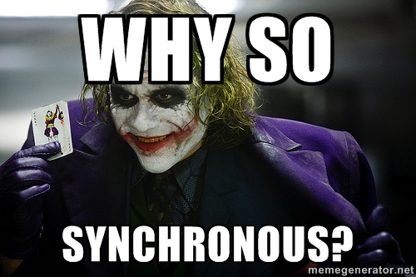
we tend to think
SYNCHRONOUSLY
Notes:
Left to right
Top to bottom
Block of code

Slide 3
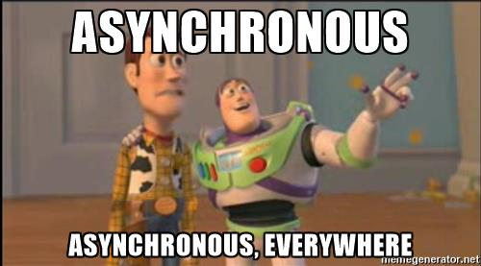
but work ASYNCHRONOUSLY
Handling user inputs
Animations
Websockets
API calls
Notes:
But when it comes to front-end devt

Slide 4
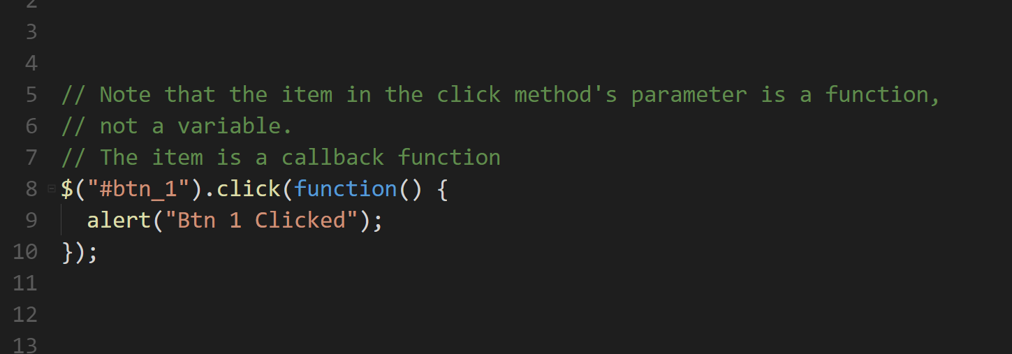

Slide 5


Slide 6
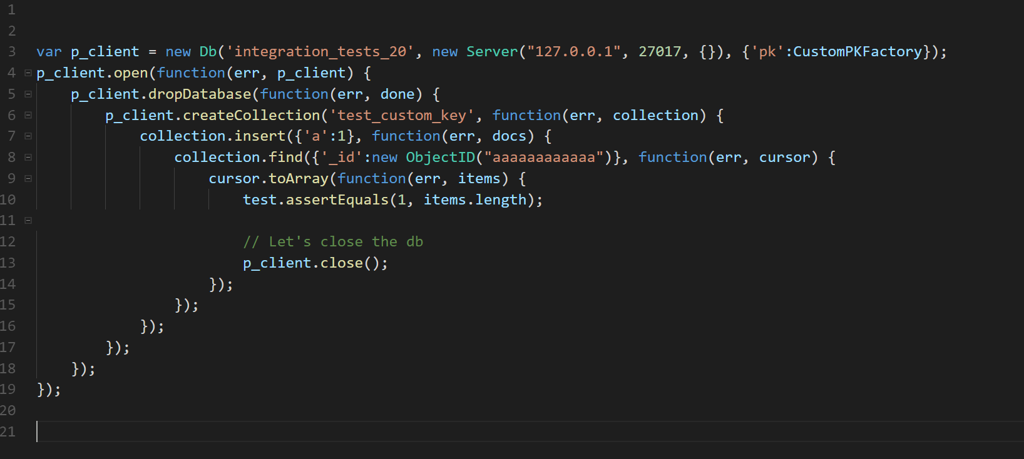

Slide 7
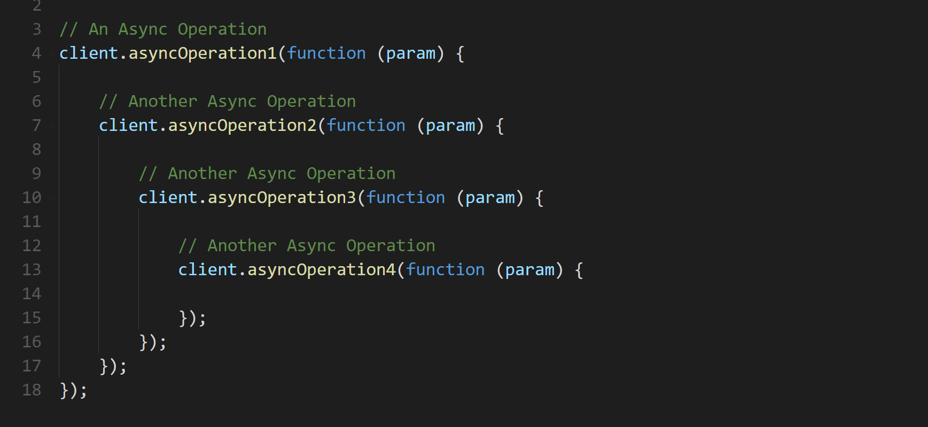

Slide 8
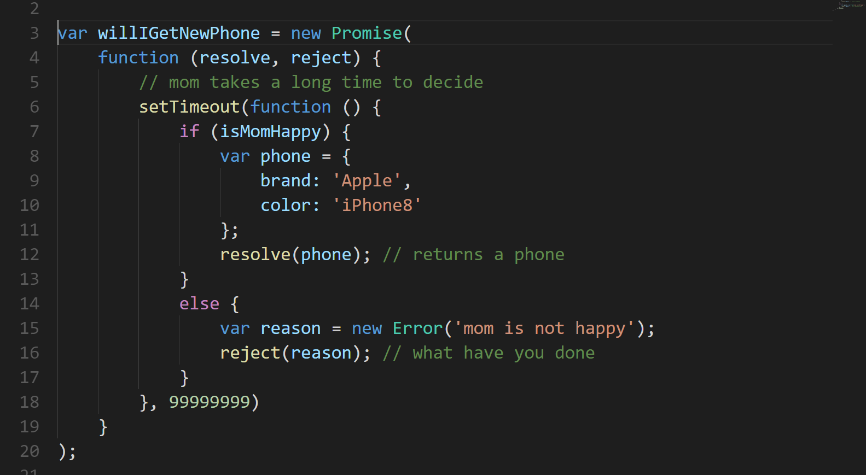

Slide 9
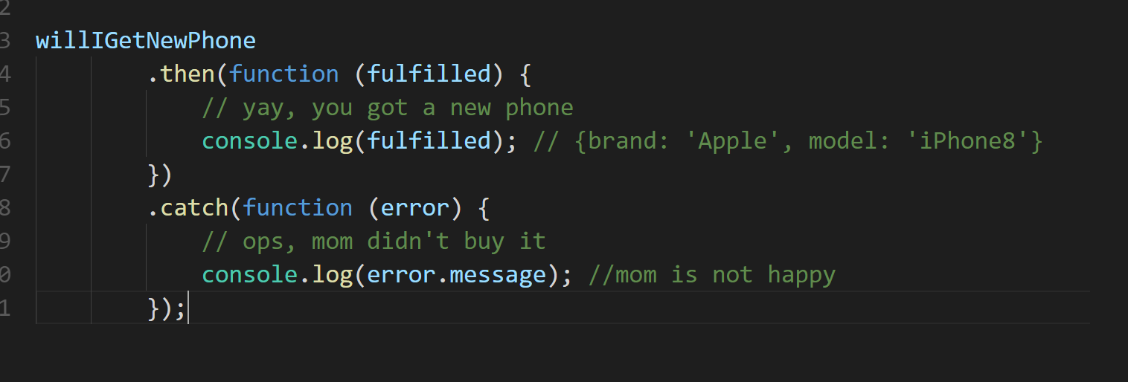

Slide 10
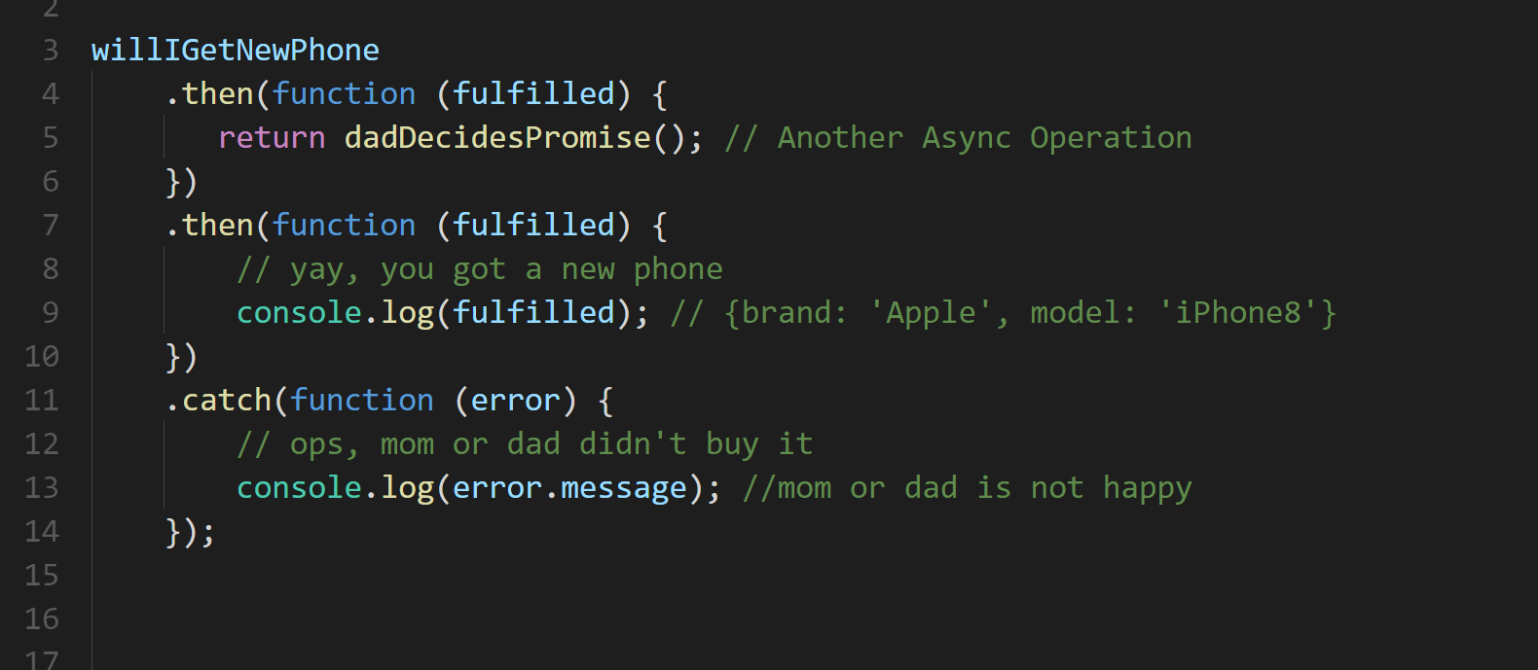

Slide 11
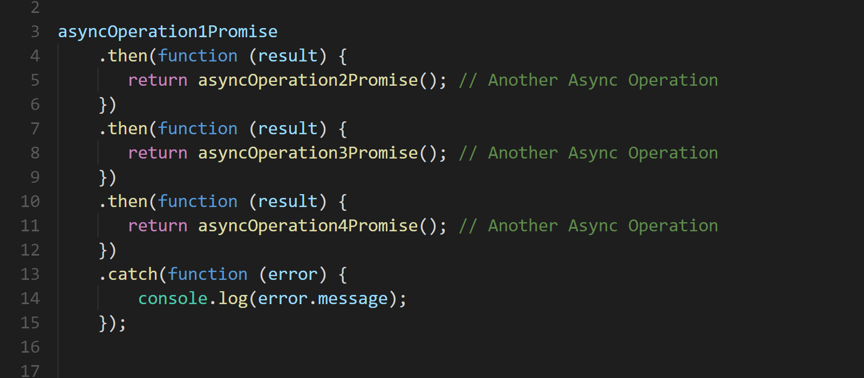
Notes:
Promises help us to better handle async

Slide 12


Notes:
Promises help us to better handle async

Slide 13
Angular and RxJS Why we want to break Promises
Rogeross Beraña
RFI Software Engineer
CACIB TECHTALK

Slide 14

Angular
a JavaScript framework that helps developers build applications
https://angular.io/
Notes:
Left to right
Top to bottom
Block of code

Slide 15

Reactive Extensions for Javascript
library for composing asynchronous and event-based programs
http://reactivex.io/
Notes:
Left to right
Top to bottom
Block of code

Slide 16
Reactive Extensions for Javascript
relies on observable sequences
http://reactivex.io/
Notes:
Left to right
Top to bottom
Block of code

Slide 17
Reactive Extensions for Javascript
used with Angular
http://reactivex.io/
Notes:
Left to right
Top to bottom
Block of code

Slide 18
PROMISE
An operation that hasn’t completed yet, but is expected in the future
Used with async/deferred operations
Can be hooked to a callback
PROMISES
and
OBSERVABLES
Notes:
Left to right
Top to bottom
Block of code

Slide 19
OBSERVABLES
An object that can be subscribed to by other objects
Can return multiple values over time – an async data stream
Event based
PROMISES
and
OBSERVABLES
Notes:
Left to right
Top to bottom
Block of code

